Slide 1

Cllr Margaret Eames-Petersen
Salisbury village ward
(Hatfield Town Council)
Save Ellenbrook Country Park- our first large Public park needed for Hatfield and Smallford residents. after Covid
Save our Water sources
Protect our residents from Silica and PM2.5 air pollution
Dangerous quarry site
Support the right HCC Mineral Plan

Slide 2
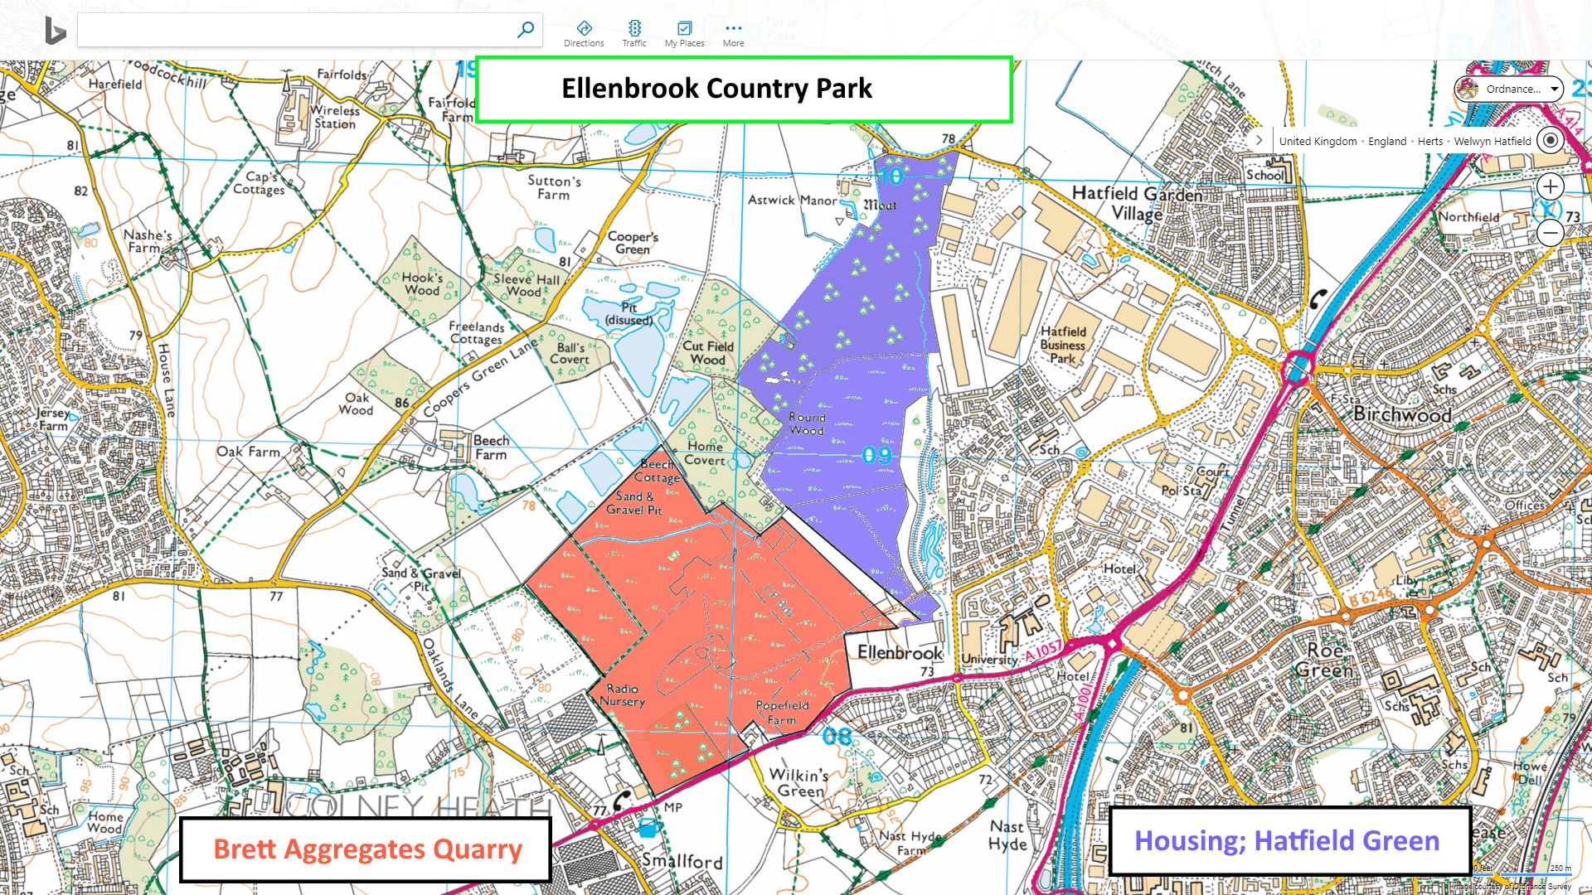
Save our Hatfield Public Park
“no” to the Aerodrome Quarry

Slide 3
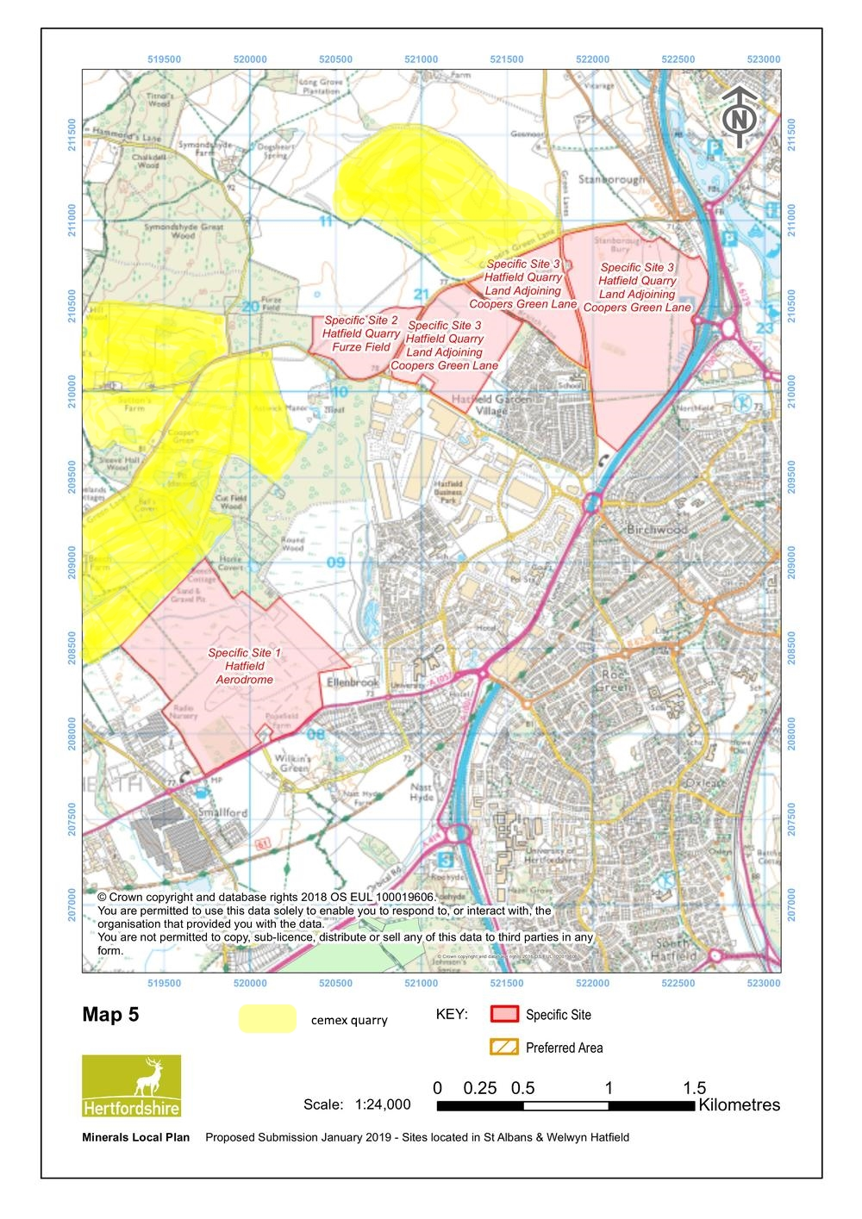
Quarries in the mineral plan
Three Quarries for Hertfordshire located in residential Hatfield-is disproportionate
This Site (1) MAS 02 – Hatfield Aerodrome – Ellenbrook
dangerous to dig LMH due to bromate (8 million tonnes)
Specific Site (2) (already dug) Hatfield Quarry – Furze Field (Cemex)
Specific Site (3) MAS03 –Hatfield Quarry – Land adjoining Coopers Green Lane (3 sites-only UMH being dug)- (Cemex)
MAS 01 – Sustainable Climate friendly site (4) – The Briggens Estate (Olives Farm) EastHerts (Not on this map)
(10.2 ++ million tonnes)

Slide 4
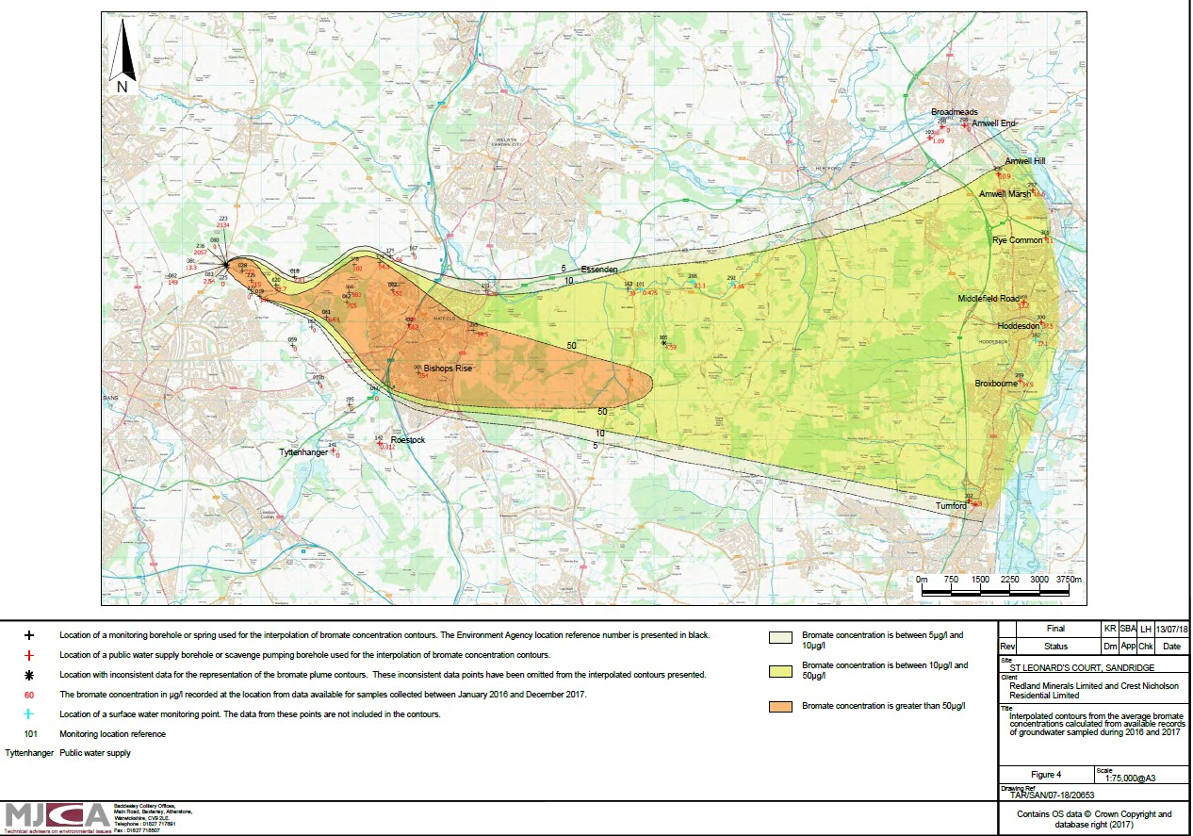
Hertfordshire’s Environmental disaster: “worst contamination of a chalk aquifer in Europe” PHE , EA The bromate plume extends 20 km underground from Sandridge, under Hatfield, to Essenden and to the River Lee, Hoddesdon & Broxbourne
Essendon

Slide 5
Protect Hertfordshire’s Water:
1. The LMH (wet sand and gravel) under Ellenbrook fields is protecting Hatfield and East Herts water from further pollution.
2. Pumping hard at Bishops Rise WPS prevents bromate exceeding WHO limit in Essenden WPS (supplying Hatfield with drinking water)- but also draws bromate under quarry site .
3. This is a unique site for remediation of the bromate for Hertfordshire and should not be lost.
4. The quarry disruption of the LMH is dangerous to disruption of the hydrogeology, and risks to our current drinking water

Slide 6
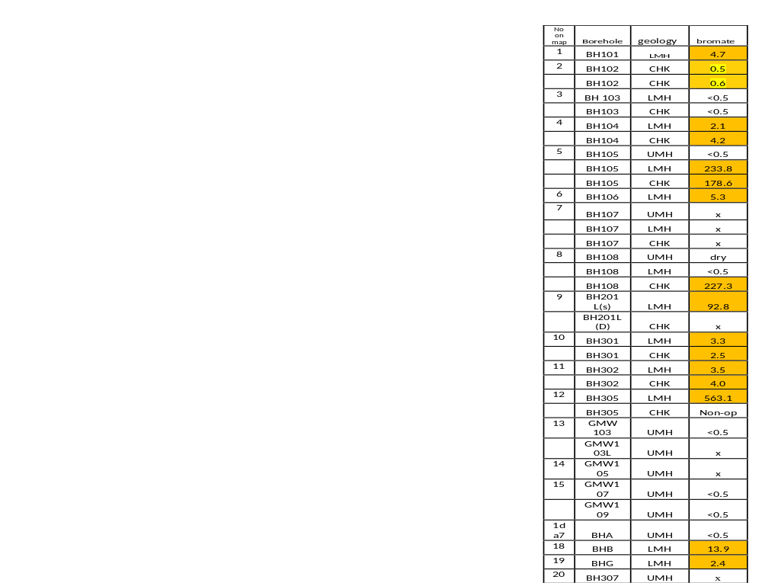
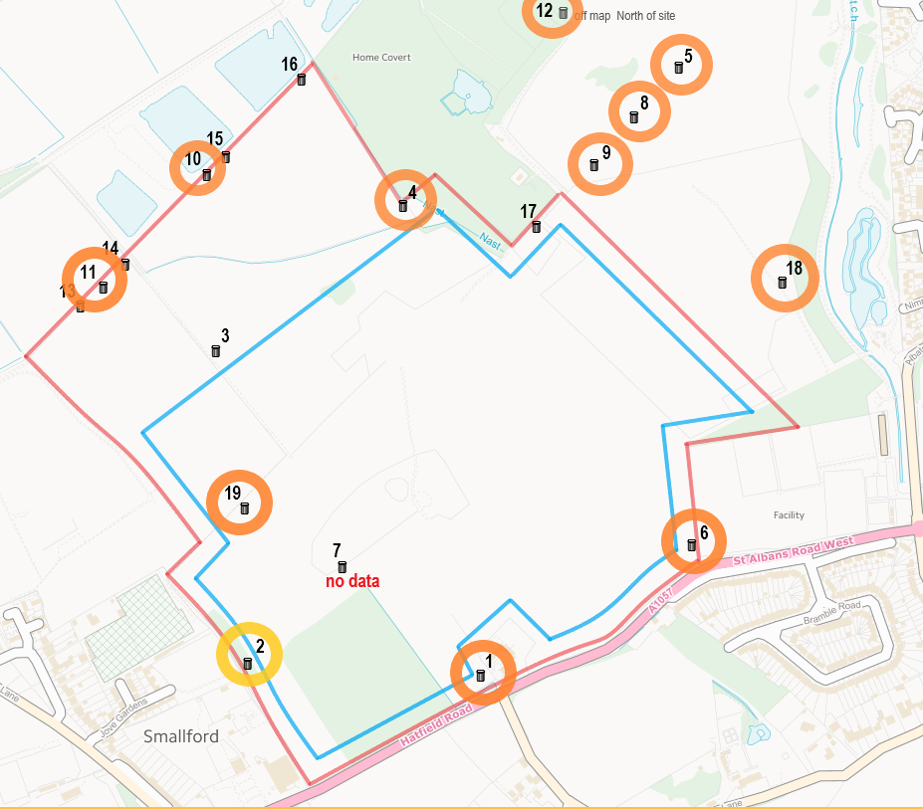
Borehole data showing bromate exceeding the EA stated plume-defintion concentration (2 µ g/l ) between 2013-2019 within Quarry site
Historic Data shows some Boreholes have levels at or above 0.5 µg/l (eg BH19 in dig site) had 2.4 µg/l in Oct 2015.
Currently some boreholes have data only to Feb 2019 and some have no updated data to show what bromate levels are present today.
Data source Brett
Key
Bromate at or above 0.5µg/l = yellow
Bromate Bromate at or above 2µg/l = orange
Below 0.5µg/l = <0.5 white
x = no data supplied
CHK = chalk.
UMH = upper mineral horizon.
LMH = lower mineral horizon
Gold

Slide 7
EA conditions on Aerodrome quarry
No mineral is extracted from within the existing plume of bromate and bromide groundwater pollution
any activities close to the plume must not change the existing hydrogeological flow regime
any activities close to the plume must not interfere with the remediation of the bromate and bromide pollution.
But remediation has failed 2008-2024, and Bromate plume Public Inquiry recommendation of 2008, needs review- report of 2023 failed to account for the quarry

Slide 8
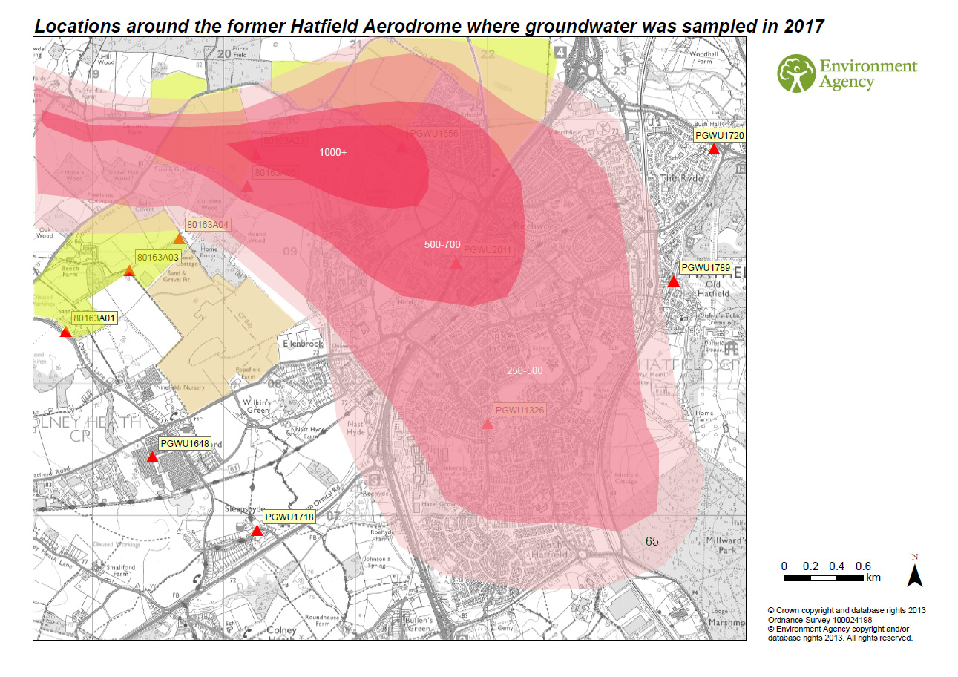
The 2nd remedial plan (2021-2030) could try to remove bromate from Ellenbrook Fields near Astwick Manor, but quarry extraction of the LMH, could jeopardise this action.

Slide 9
Urgent need for better bromate remediation
One recommendation is to remove bromate from the highest concentration areas:
Three borehole sites- nearer the source accessible for further remediation in 2020
St Leonards Court – Orchard grange ………………314µg/l
Woodcock Hill – Nashes Farm ………………………..537µg/l
Ellenbrook fields –near to Astwick Manor ….1000µg/l

Slide 10
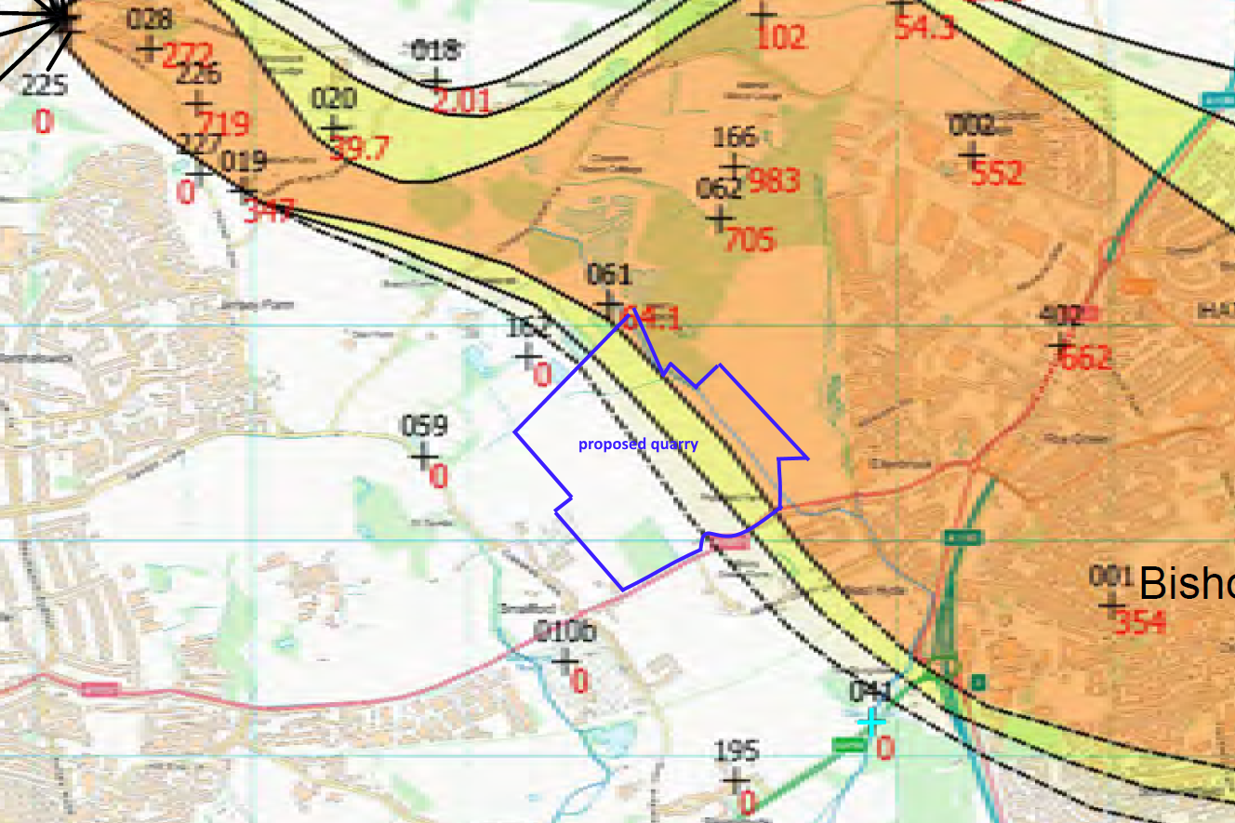
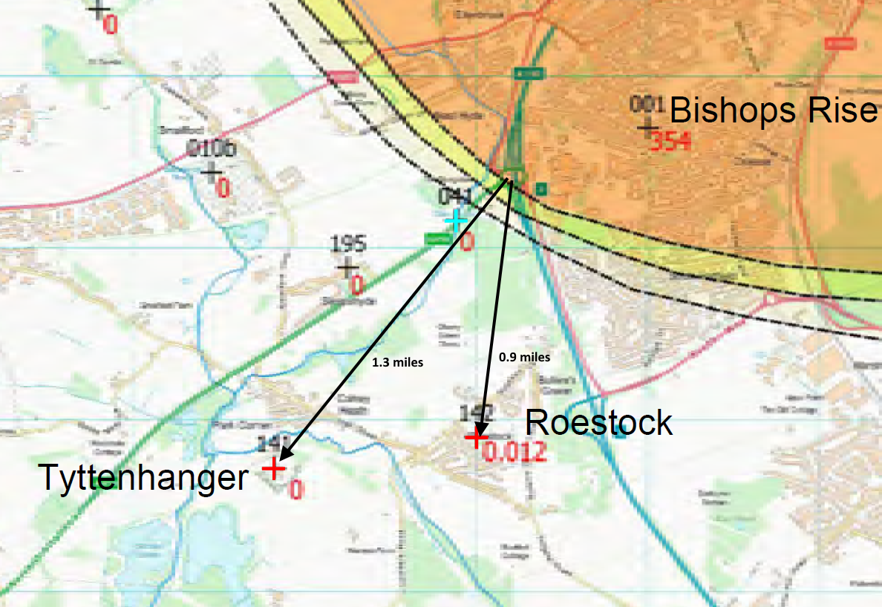
The plume bisecting 1/3 Quarry site & 0.9 mile from Roestock (PWS), Colney Heath- disturbance of the LMH could jeopardise this source for Hatfield.

Slide 11
Other hazardous health factors:
1. UH students’ sportfield right next to quarry site
Inhaling silica dust- harmful to lungs,
2. 2000 students residences next door (10 halls of residence)
3. Three housing estates right next to the quarry, Ellenbrook, Salisbury village, Smallford (>5000 residents)
4. Diesel fumes with PM2.5, from extra quarry lorries on A1057, a residential road, are harmful (CHD, and Lung disease) and likely to increase mortality.
5. Public health - Loss of Ellenbrook fields, which is Hatfield’s first public park, used for exercise, fresh air, was used weekly for park run(300), local school, dog walking and cycling.
6. Flooding risk to Ellenbrook (due to impermeable back-fill)

Slide 12
In Conclusion
Hatfield residents need this public park- which was invaluable in Covid 19.
The carcinogenic bromate plume , is so close to this site ,please do not risk the drinking water in Hatfield again –follow the precautionary principle.
Affinity Water have taken out a private agreement with Brett, due to the risks of bromate pollution, and for monitoring the remediation .
EA conditions almost certainly to be breached at the start.
Why risk the Herts Mineral Plan failing? –when there is a larger alternative more sustainable site without bromate in East Herts, few receptors, producing more sand and gravel, not near housing, on the A414, with canal boat navigation (Rivers Stort and Lee) possible for export to A10/M11 or rail.
Please reject this quarry. Thank you for Listening

