Slide 1
Public Access Changes
PAS 23 v PAS 26
Hatfield Aerodrome

Slide 2
Presentation Covers
A promise - This is NOT death by PowerPoint
Design features linked to
management of groundwater and surface water
Key PAS 26 improvements
  Additional paths
  Substages
  Two Options

Slide 3
Groundwater and water monitoring management plan
GWMMP

Slide 4
Design for GWMMP and public access
Three features for GWMMP in design
Clay seals around phases to isolate upper aquifer
Infiltration lagoons down gradient from quarry
Work Phases A and Phase B first
These are on the agenda for separate discussion

Slide 5
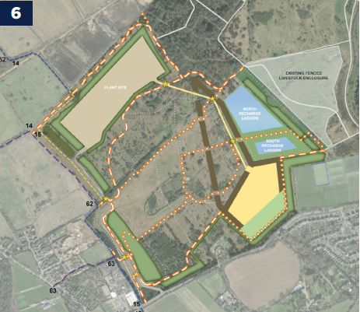
Three GWMMP Features
Infiltration Lagoons
Clay Seals
Work Phase A & B First

Slide 6
PAS 2026 Improvements

Slide 7
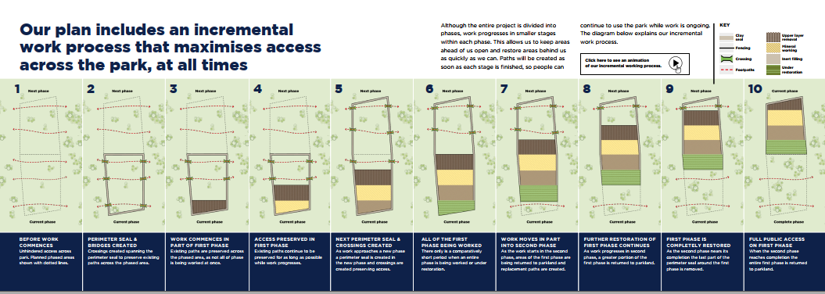
Substages within Phases
gat04-live-1517c8a4486c41609369c68f30c8-aa81074.divio-media.org/filer_public/b6/2b/b62b94e6-a60a-43c6-9e30-0d109d206187/cd17021_25_brt_0171_hatfield_appeal_document_-_animation_1_v1a.mp4

Slide 8
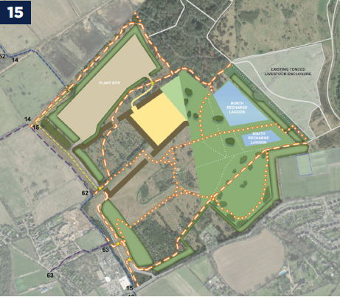
Examples of Additional Routes
(Taken from Option 2)
Additional east/west link between lagoons
Additional cross park routes
Redesign of southern multiuser route
enhances disabled access (taxiway)
Increase commuting

Slide 9
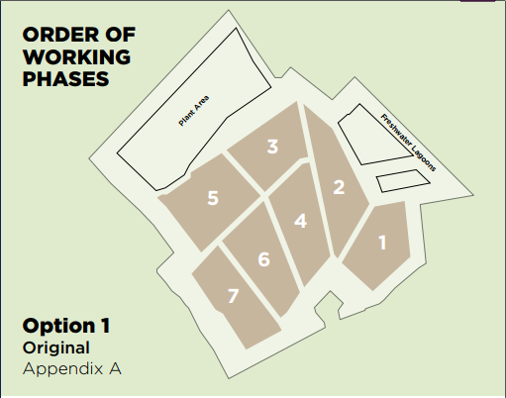
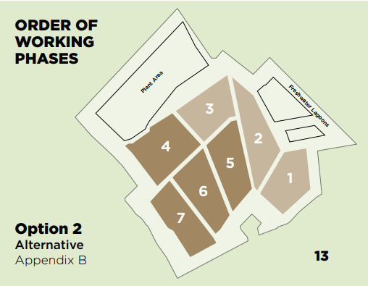
Two Options for working Phases
(Option 2 regarded as better)
gat04-live-1517c8a4486c41609369c68f30c8-aa81074.divio-media.org/filer_public/7c/e2/7ce2ad66-6ad6-4b45-b8d2-9d624635eda5/cd17022_25_brt_0171_hatfield_appeal_document_-_animation_2_v2.mp4
gat04-live-1517c8a4486c41609369c68f30c8-aa81074.divio-media.org/filer_public/d1/56/d156c279-2f8b-431c-be0e-36556ffc9f75/cd17023_25_brt_0171_hatfield_appeal_document_-_animation_3_v2.mp4

Slide 10
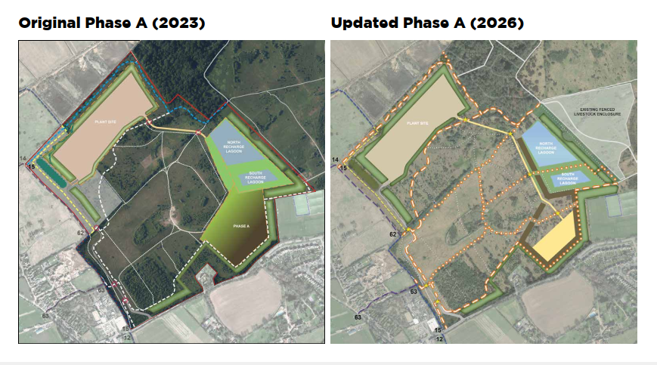
PAS 23 v PAS 26 (Option 1 comparison)

Slide 11
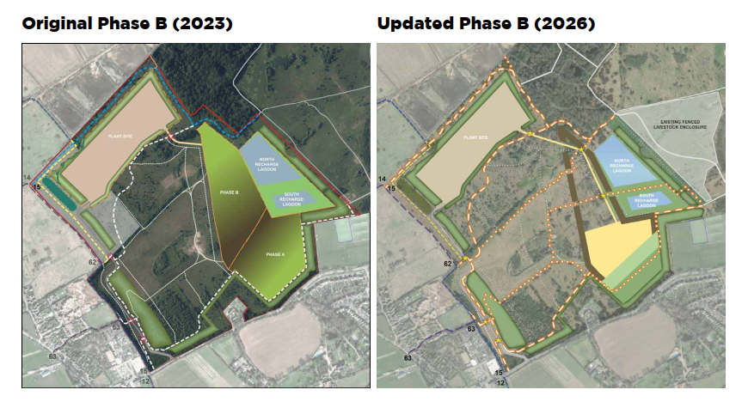
PAS 23 v PAS 26 (Option 1 comparison)

Slide 12
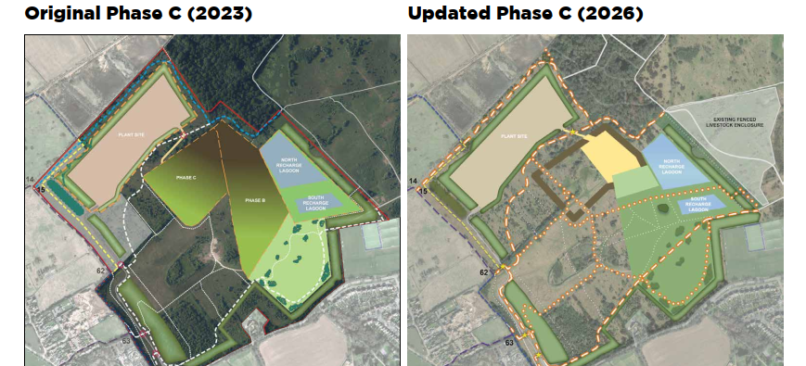
PAS 23 v PAS 26 (Option 1 comparison)

Slide 13
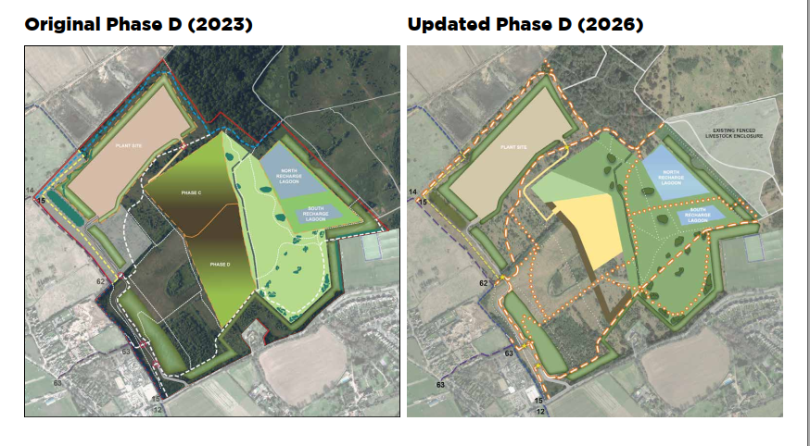
PAS 23 v PAS 26 (Option 1 comparison)

Slide 14
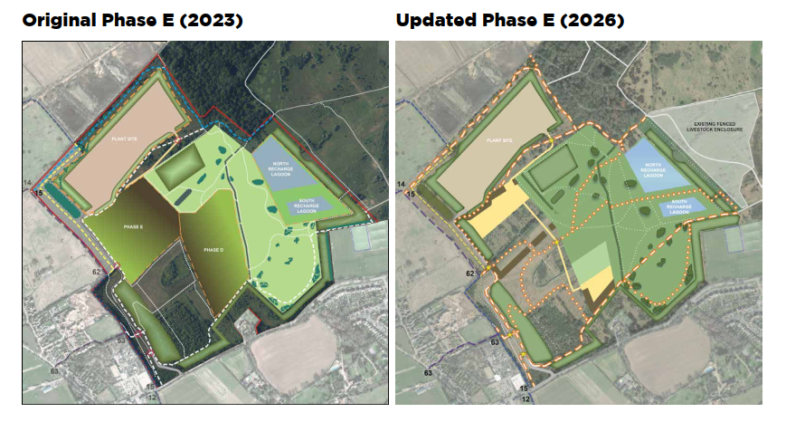
PAS 23 v PAS 26 (Option 1 comparison)

Slide 15
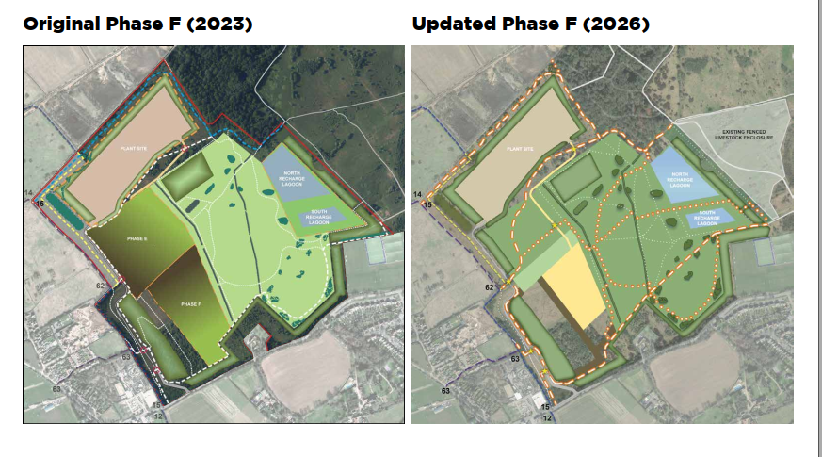
PAS 23 v PAS 26 (Option 1 comparison)

Slide 16
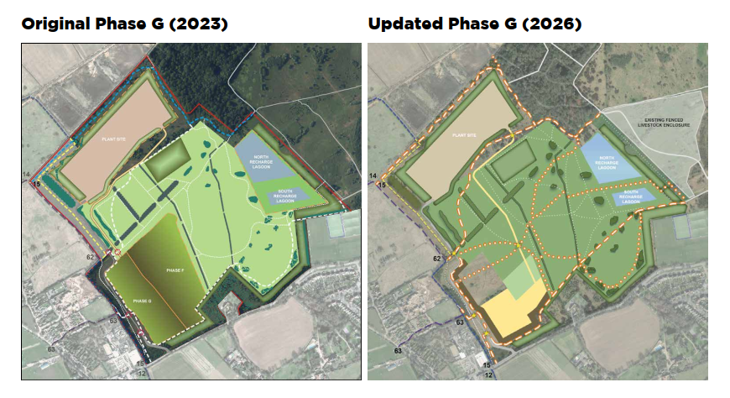
PAS 23 v PAS 26 (Option 1 comparison)

